Slide 1
Presentation Air Quality Monitoring and Its Correlation with Public Health: A Machine Learning-Based Analysis Using Real-World Data
Presented By:
Nusrat Jahan Suborna
MD Mostafa Jaman Rabby

Slide 2
Introduction
The primary goal of this study is to investigate how the air quality in Dhaka affects the general public's health, particularly respiratory conditions and death rates, using machine learning techniques. The study will look at correlations and patterns that show how pollution influences the incidence of respiratory diseases and mortality by analyzing data on air quality and health records. Bar charts will be utilized to show the number of deaths connected to decreasing air conditions, while scatter plots will be used to show the association between air quality levels and new cases of respiratory disorders.

Slide 3
Data Overview
YEAR | JAN | FEB | MAR | APR | MAY | JUN | JUL | AUG | SEP | OCT | NOV | DEC
2016 | 232.2903 | 228.7586 | 171.2258 | 198.3667 | 202.6774 | 154.9667 | 185.9032 | 166.5484 | 121.1667 | 133.2258 | 230.3333 | 223.1935
2017 | 278.4839 | 239.75 | 165.9677 | 176.6339 | 163.1935 | 147.2667 | 175.6774 | 143.0323 | 105.2 | 117.2258 | 258.9333 | 245.0968
2018 | 296.5484 | 241 | 181.2258 | 277.3398 | 239.6129 | 140.9655 | 202.7097 | 108.8387 | 116.1 | 131.7742 | 265.8 | 274.4839
2019 | 300.7097 | 250.5357 | 191.5161 | 242.9306 | 132.4194 | 136.8 | 177.7097 | 137.33 | 126.1667 | 133.871 | 270.3667 | 286.6774
2020 | 295.9032 | 268.3103 | 144.78 | 121.276 | 108.9 | 91.63333 | 78.09677 | 79.12903 | 92.03333 | 126.8065 | 165.7667 | 173
2021 | 132.9857 | 113.6735 | 96.349 | 97.878 | 102.87 | 86.7 | 78.985 | 67.44 | 89.56 | 110.78 | 138.56 | 158.78
2022 | 294.5934 | 267.896 | 202.56 | 156.89 | 185.621 | 140.1093 | 156.45 | 128.89 | 123.9421 | 162.593 | 288.234 | 298.458
2023 | 302.1132 | 298.569 | 214.923 | 178.82 | 206.78 | 144.315 | 164.834 | 132.231 | 137.845 | 184.7934 | 304.43 | 318.567

Slide 4
Year | Patients_Admitted | Deaths
2016 | 65727 | 3831
2017 | 63872 | 5671
2018 | 65832 | 9733
2019 | 60758 | 12983
2020 | 408419 | 98911
2021 | 765352 | 62512
2022 | 81765 | 23690
2023 | 50672 | 8468

Slide 5
Month | Z | P-value | S | varS | Tau | Sens Slope
Jan | 0.866 | 0.3864 | 8.0 | 65.33 | 0.28571 | 3.58
Feb | 1.855 | 0.0634 | 16.0 | 65.33 | 0.5714 | 8.38
Mar | 0.8660 | 0.3864 | 8.0 | 65.33 | 0.28571 | 5.59
Apr | -0.866 | 0.3864 | -8.0 | 65.33 | -0. 28571 | -17.24
May | -0.371 | 0.7105 | -4.0 | 65.33 | -0.14285 | -6.29
Jun | -1.36 | 0.1735 | -12.0 | 65.33 | -0.42857 | -4.54
Jul | -1.113 | 0. 2655 | -10.0 | 65.33 | -0. 35714 | -4.37
Aug | -1.36 | 0.1735 | -12.0 | 65.33 | -0.42857 | -5.89
Sep | 0.3711 | 0.7105 | 4.0 | 65.33 | 0.14285 | 1.81
Oct | 0.866 | 0.386 | 8.0 | 65.33 | 0.2857 | 6.130
Nov | 1.113 | 0.2655 | 10.0 | 65.33 | 0.3571 | 6.411
Dec | 1.113 | 0.2655 | 10.0 | 65.33 | 0.3571 | 11.432

Slide 6
Data Sorting and Cleaning
The data cleaning and sorting process for the PM2.5 air quality dataset began with loading the daily data for the years 2016 to 2023, ensuring the dataset included two key columns: Date and PM2.5. Missing values in the PM2.5 column were addressed by applying an imputation strategy, where missing entries were filled with the mean value of the column. After ensuring data integrity, the Date column was converted into a DateTime format, and additional columns for Year and Month were extracted to facilitate grouping. The data was then grouped by Year and Month, and the average PM2.5 values for each month were calculated to create a monthly average dataset. To ensure completeness, any missing months in the grouped data were identified and filled using linear interpolation. This cleaned and aggregated monthly dataset was then exported for further analysis, providing a robust foundation for examining air quality trends and their implications.

Slide 7
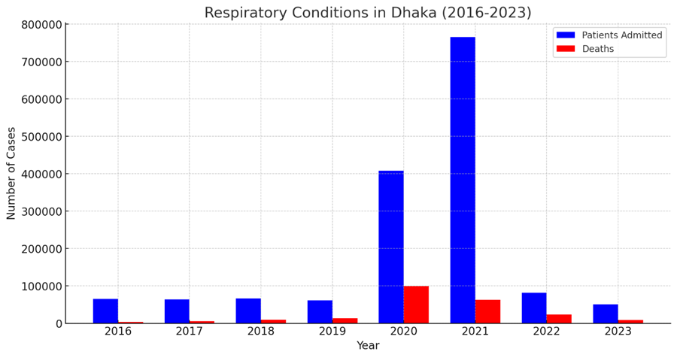
Respiratory Conditions in Dhaka (2016-2023)

Slide 8
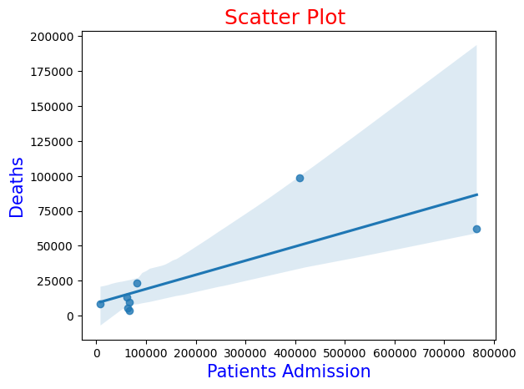
Correlation

Slide 9
Conclusion
Through the use of Python and robust statistical analysis techniques, such as the calculated Pearson correlation coefficient and p-value, the project will quantify the strength and significance of the relationship between air pollutants and respiratory health. This data-driven approach will contribute to heightened societal awareness of the adverse effects of poor air quality, empowering stakeholders to take meaningful actions to mitigate these challenges.
The proposed research aligns with global efforts to improve public health and promote environmental sustainability. By addressing the complexities of air pollution and its cascading impacts on respiratory illnesses, the project will serve as a foundation for future studies and inform policy recommendations.

